Slide 1
XAML Controls Developer’s Guide to Windows 10
Christopher G. Misola
Elinnov | Seaversity | Hubnob.TV : Co-Founder
Former Technical Evangelist - Microsoft

Slide 2
Controls in the XAML toolbox

Slide 3


Adaptive controls

Slide 4


Input intelligence

Slide 5
Using standard controls gets you a long way

Slide 6
Layout controls
Windows XAML layout controls
Stack Panel
Canvas
Scroll Viewer
Border
Grid
View Box
Wrap Grid
Relative Panel

Slide 7
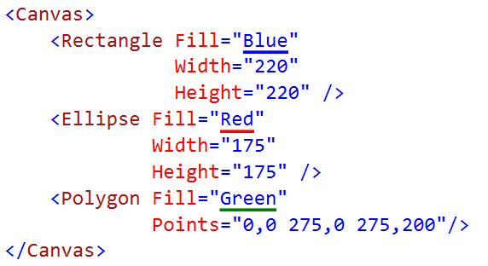

Canvas

Slide 8

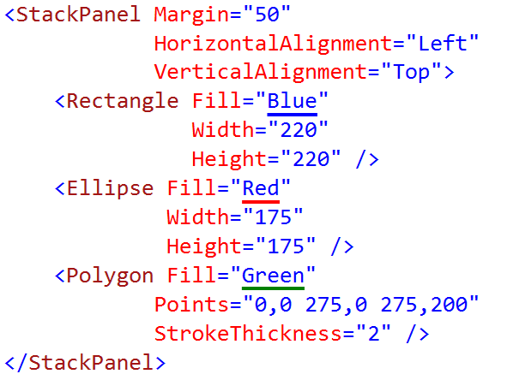
StackPanel

Slide 9
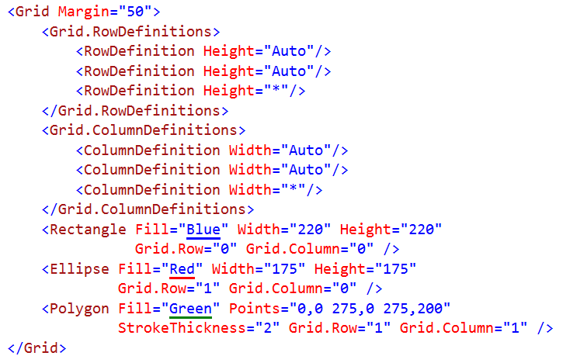
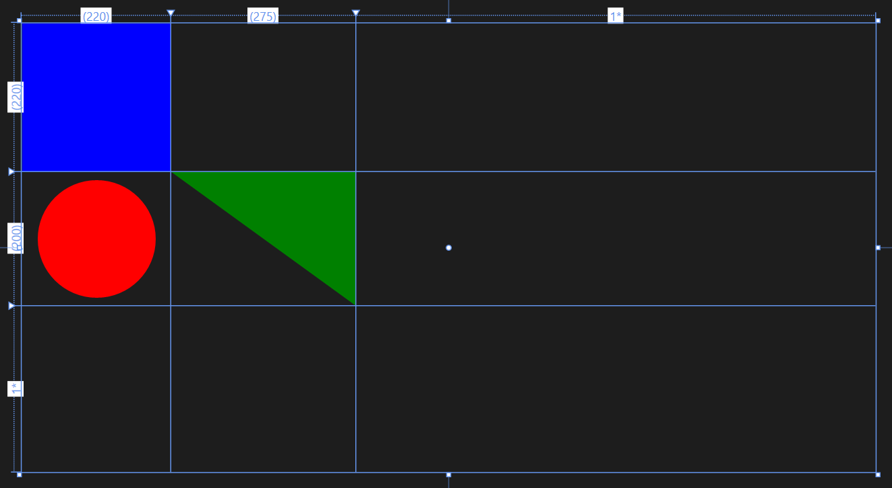
Grid

Slide 10
Proportional layout with Grid
2*
1*
auto
Rows/columns – 3 types of sizing:
star sizing
proportional: 1*/3* = 25%/75%
auto sizing
sized to content
content can also have Max/Min widths and heights as limits
pixel sizing
hard-coded size – avoid in most situations
7*
auto
4*
1*

Slide 11
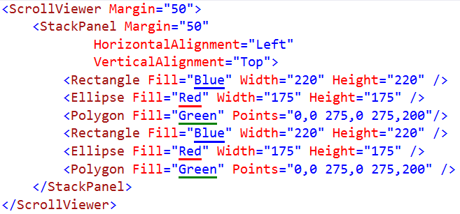

ScrollViewer

Slide 12
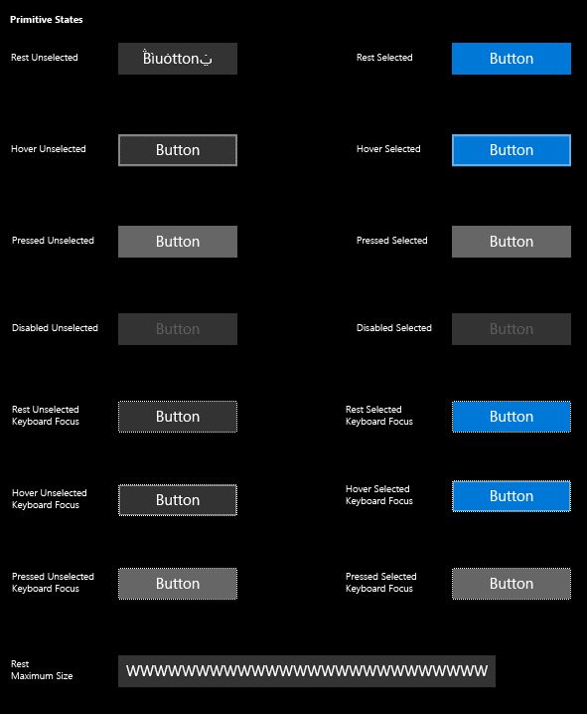
Buttons
<Button Content="" />
<HyperlinkButton />
<RepeatButton />
<ToggleButton IsChecked="" />

Slide 13
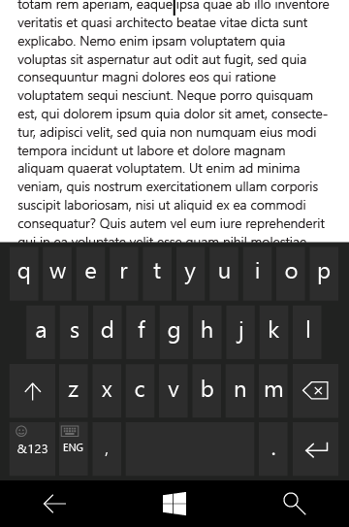
Text controls
<TextBox Text="" />
<PasswordBox Text="" />
<TextBlock Text="" />
<RichEditBox Content="" />
<RichTextBlock Content="" />
<BitmapIcon UriSource="" />
<FontIcon Glyph="" />
<SymbolIcon Icon="" />
<PathIcon Data="" />

Slide 14
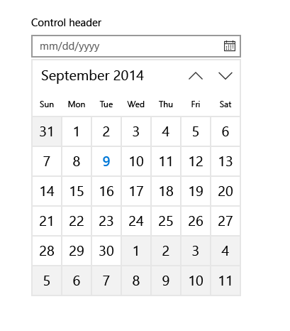
Selection and picker controls
<CalendarView />
<DatePicker Date="" />
<TimePicker Time="" />
<ToggleSwitch IsChecked="" />
<CheckBox IsCHecked="" />
<RadioButton IsChecked="" />
<ComboBox />
<ListBox />
<Slider Minimum="" Maximum="" />

Slide 15
Collection/data controls
<ItemsControl ItemsSource="" />
<FlipView />
<GridView />
<ListView />
<SematicZoom />
<Hub Orientation="" />
<ContentControl ControlTemplate="" />
<DataTemplate />
<ItemsPanelTemplate />
<ControlTemplate />
<ContentPresenter />
<ItemsPresenter />
<ContentControl />

Slide 16
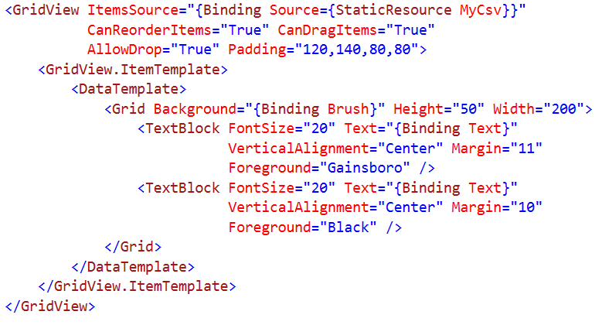
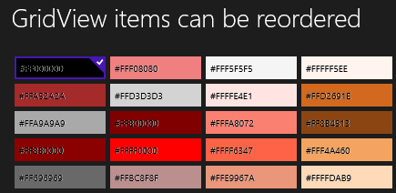
Grid View Syntax

Slide 17
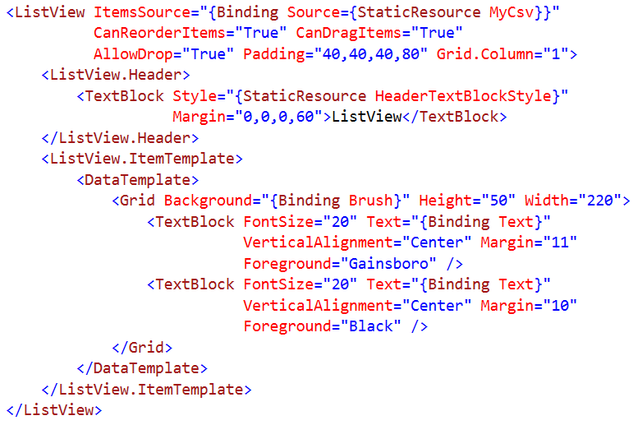
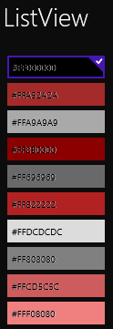
List View Syntax
Notes:
<ListView x:Name="StudentsList" />
…
public class Student { public string Name { get; set; } public int Age { get; set; } }
…
private List<Student> listOfStudents = new List<Student>();
…
listOfStudents.Add(new Student { Name = "John", Age = 20 });
listOfStudents.Add(new Student { Name = "Bob", Age = 21 });
StudentsList.ItemsSource = listOfStudents;
…
<ListView x:Name="StudentsList">
<ListView.ItemTemplate>
<DataTemplate>
<StackPanel>
<TextBlock Text="{Binding Name}"/>
<TextBlock Text="{Binding Age}"/>
</StackPanel>
</DataTemplate>
</ListView.ItemTemplate>
</ListView>

Slide 18
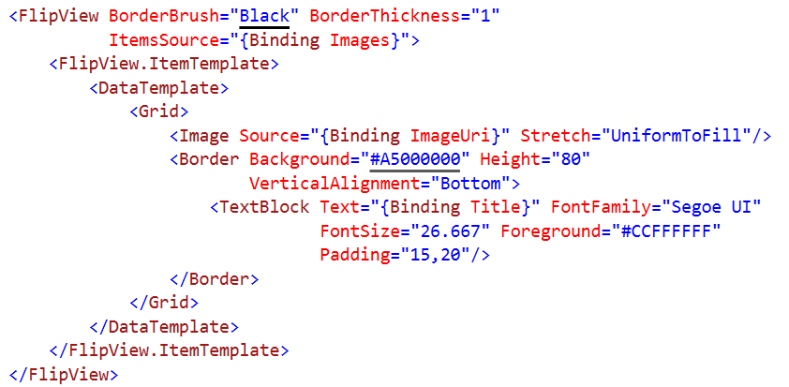

Flip View Syntax
Notes:
<FlipView x:Name="flipView1">
<Image Source=“photo1.jpg" />
<Image Source=“photo2.jpg" />
<Image Source=“photo3.jpg" />
</FlipView>

Slide 19
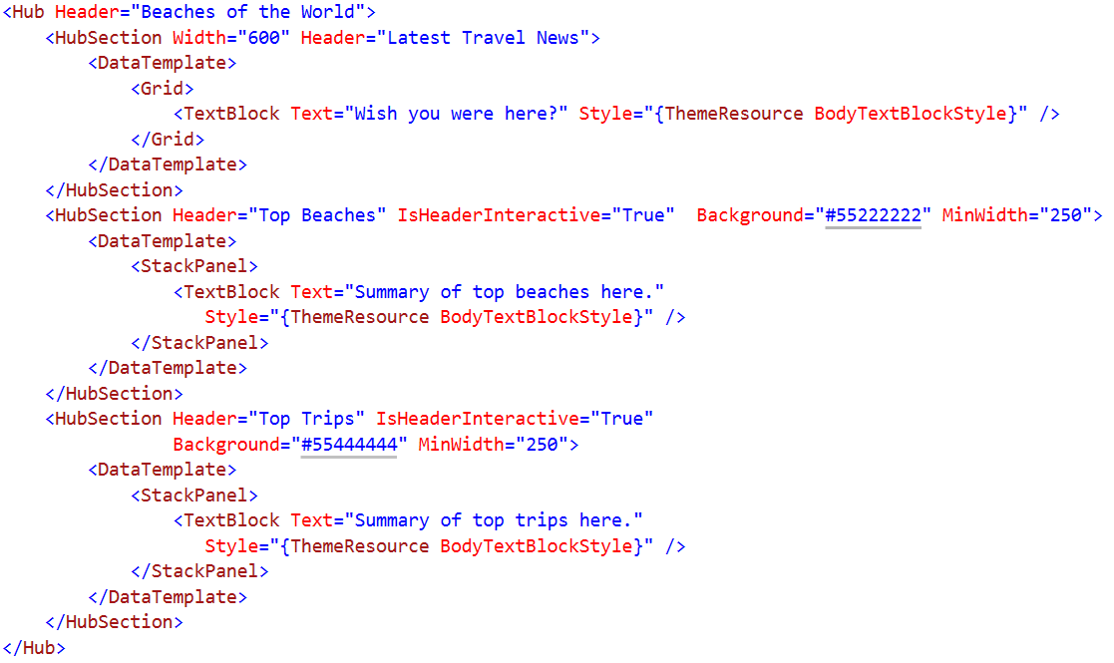

Hub Syntax

Slide 20
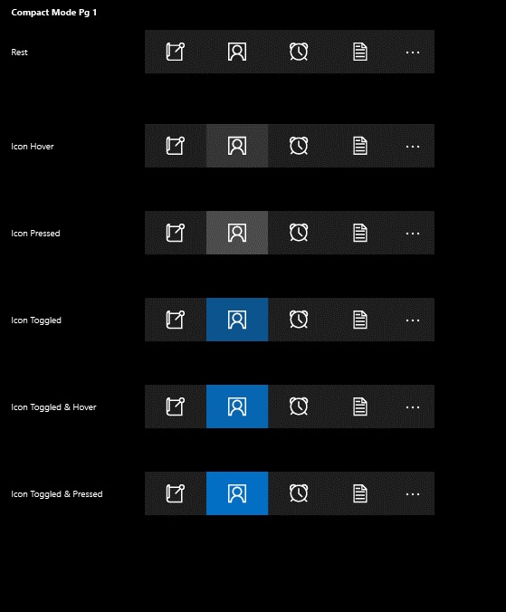
App bars and commands
<AppBar />
<CommandBar />
<AppBarButton Label="" Icon="" />
<AppBarToggleButton IsChecked="" />
<AppBarSeparator />
Notes:
<CommandBar>
<AppBarToggleButton Icon="Shuffle" Label="Shuffle"/>
<AppBarToggleButton Icon="RepeatAll" Label="Repeat"/>
<AppBarSeparator/>
<AppBarButton Icon="Back" Label="Back"/>
<AppBarButton Icon="Stop" Label="Stop"/>
<AppBarButton Icon="Play" Label="Play"/>
<AppBarButton Icon="Forward" Label="Forward"/>
<CommandBar.SecondaryCommands>
<AppBarButton Icon="Like" Label="Like"/>
<AppBarButton Icon="Dislike" Label="Dislike"/>
</CommandBar.SecondaryCommands>
<CommandBar.Content>
<TextBlock Text="Now playing..." Margin="12,14"/>
</CommandBar.Content>
</CommandBar>

Slide 21
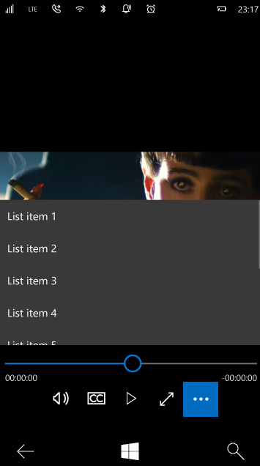
Progress, Media & Inking controls
<ProgressBar IsIntermediate="" />
<ProgressRing IsActive="" />
<Image />
<InkCanvas />
<MediaElement />
<CaptureElement />
Notes:
<MediaElement x:Name="mediaPlayer" Source="video.mp4" AutoPlay="False" AreTransportControlsEnabled="True" />
-------------------------------------------------------------------------
<InkCanvas x:Name="MyInkCanvas"/>
…
MyInkCanvas.InkPresenter.InputDeviceTypes =
Windows.UI.Core.CoreInputDeviceTypes.Touch |
Windows.UI.Core.CoreInputDeviceTypes.Mouse;
…
<InkCanvas x:Name="MyInkCanvas" />
<InkToolbar x:Name="inkToolbar"
VerticalAlignment="Top"
TargetInkCanvas="{x:Bind MyInkCanvas}"
InitialControls="All">
</InkToolbar>
-------------------------------------------------------------------------
<CaptureElement Name="captureElement" />
…
private async void init()
{
MediaCapture mediaCapture = new MediaCapture();
await mediaCapture.InitializeAsync();
captureElement.Source = mediaCapture;
await mediaCapture.StartPreviewAsync();
MediaCaptureFailedEventHandler handler = (sender, e) =>
{
System.Threading.Tasks.Task task = System.Threading.Tasks.Task.Run(async () =>
{
await new MessageDialog("There was an error capturing the video from camera.", "Error").ShowAsync();
});
};
}

Slide 22
Navigation

Slide 23
Frame.Navigate
Send to a type
Pass a string
Navigation service
Part of Template 10 project template
private void Goto2(object sender, Windows.UI.Xaml.RoutedEventArgs e)
{
var app = App.Current as Common.BootStrapper;
var nav = app.NavigationService;
nav.Navigate(typeof(Views.Page2), "My parameter value");
}

Slide 24
Navigation parameters
Page.OnNavigatedTo()
Standard in Windows
ViewModel.OnNavigatedTo
With Template 10 project template
public override void OnNavigatedTo(string parameter,
NavigationMode mode, IDictionary<string, object> state)
{
this.Parameter = parameter?.ToString() ?? "Empty";
}

